Slide 1
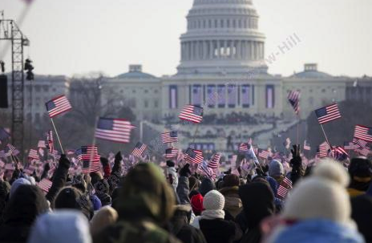
Influencing the Political
Environment
Chapter 8
©2020 McGraw-Hill Education. All rights reserved. Authorized only for instructor use in the classroom. No reproduction or further distribution permitted without the prior written consent of McGraw-Hill Education.

Slide 2
The Arguments for and
Against Political Involvement by Business
From Figure 8.1
Copyright © McGraw-Hill Education. Permission required for reproduction or display.
Why Business Should Be Involved | Why Business Should Not Be Involved
A pluralistic system invites many participants. | Managers are not qualified to engage in political debate.
Economic stakes are high for firms. | Business is too big, too powerful—an elephant dancing among chickens.
Business counterbalances other social interests | Business is too selfish to care about the common good.
Business is a vital stakeholder of government. | Business risks its credibility by engaging in partisan politics.
Notes:
This debate involves the question of whether, and to what extent, business should legitimately participate in the political process.
This justice and fairness argument becomes even stronger when one considers the significant financial consequences that government actions may have on business.
Businesses see themselves as countervailing forces in the political arena.

Slide 3

Types of Corporate Political Strategy
Why Businesses get involved in politics?
Three strategic types:
Information strategy
Financial-incentives strategy
Constituency-building strategy
Notes:
Involves the activities taken by organizations to acquire, develop, and use power to obtain an advantage
To further a firm’s economic survival or growth.
May target limiting a competitor’s progress or ability to compete.
May exercise the business’s right to a voice in government affairs
Such as participation in the presidential advisory council. Companies develop an ongoing political strategy.
Example: Technology firms supporting the Honest Ads Act.
Three strategic types:
Information strategy
Businesses seek to provide government policymakers with information to influence their actions.
Financial-incentives strategy
Businesses provide incentives to influence government policymakers to act in a certain way.
Constituency-building strategy
Businesses seek to gain support from other affected organizations to better influence government policymakers to act in a way that helps them.

Slide 4
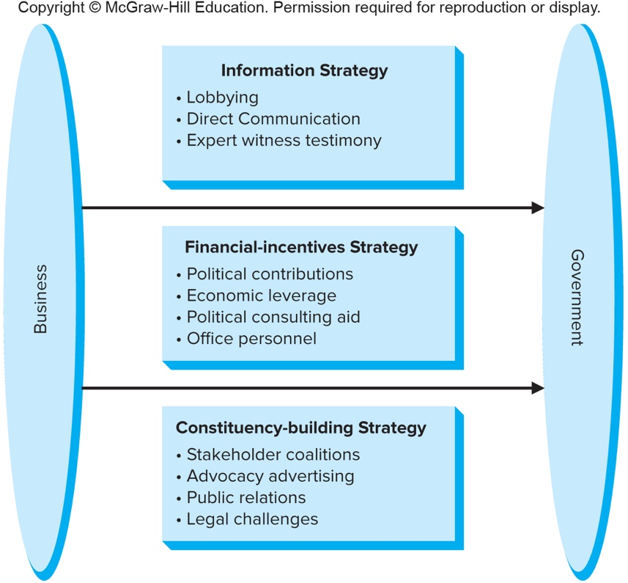
Business Strategies for Influencing Government
Copyright © McGraw-Hill Education. Permission required for reproduction or display.
Figure 8.2
Access the text alternative for these images.
Notes:
Here you can see the different strategies applicable to each type of engagement

Slide 5

Promoting an Information Strategy:
Lobbying1
Lobbying: direct contact with a government official to influence the thinking/actions of that person on an issue or public policy.
Lobbyists role:
    Communicate with and try to persuade others to support an organization’s interest.
Revolving door: when businesses hire former government officials as lobbyists and political advisors.
Notes:
Lobbying: direct contact with a government official to influence the thinking/actions of that person on an issue or public policy.
Lobbyists role:
Communicate with and try to persuade others to support an organization’s interest.
Revolving door: when businesses hire former government officials as lobbyists and political advisors.
Under U.S. law and EU directive, lobbying activities are severely limited and disclosed publicly.
(Talk about limitations in US compared to other countries)
Lobbying firms and organizations employing in-house lobbyists must:
Register with the government.
Must file regular reports on their earnings or expenses.
Indicate the issues and legislation that were the focus of their efforts.
These rules are to guarantee that politicians are free from undue influence and represent the public interest.

Slide 6
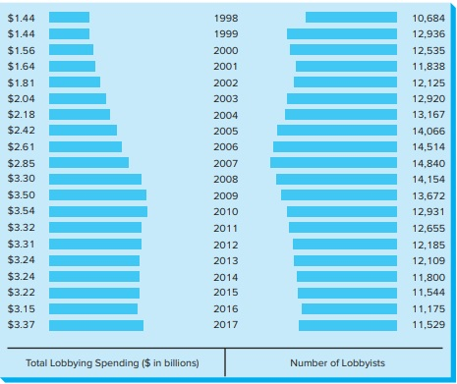
Total Federal Lobbying Spending and Number of Lobbyists, 1998 to 2017
Copyright © McGraw-Hill Education. Permission required for reproduction or display.
Figure 8.3
Access the text alternative for these images.

Slide 7



Promoting an Information Strategy:
Direct Communications
The Business Roundtable
Businesses provide facts, anecdotes, or data:
Notes:
Direct Communications
Businesses invite officials to participate in activities that will improve government officials’ understanding of management and employee concerns.
The Business Roundtable
Organization of CEOs of leading corporations (founded in 1972). Promote direct communication between business and policymakers. Studies various public policy issues. Advocates for laws it believes “foster vigorous economic growth and a dynamic global economy.”
Businesses provide facts, anecdotes, or data:
to educate or influence government leaders at public forums like congressional hearings.

Slide 8

Promoting a Financial Incentive Strategy: Political Action Committees
  Independently incorporated organizations.
  Active in industries that are highly regulated.
  Disadvantage
Notes:
Independently incorporated organizations.
Solicit contributions and channel those funds to candidates seeking political office.
Active in industries that are highly regulated.
Example: financial services and health care industries.
Disadvantage:
Contributions are capped at fairly low levels.
Companies cannot give money directly to their affiliated PACs.

Slide 9
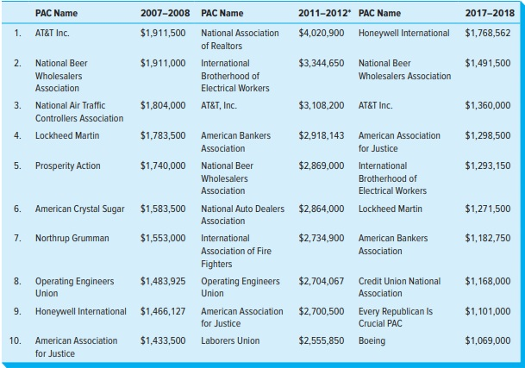
Political Action Committee Activity
Figure 8.4
Copyright © McGraw-Hill Education. Permission required for reproduction or display.
Access the text alternative for these images.

Slide 10

Promoting a Financial Incentive Strategy:
  Super PACs
  Tax-exempt Organizations:
  Direct Contribution by Corporations
  Executive and Employee Personal Contributions
  Economic leverage
Notes:
Super Pacs
As long as PACs did not contribute directly to other bodies, they could accept unlimited contributions from individuals/ unions/
corporations. To support particular candidates or parties.
Example: the Senate Majority PAC and the Congressional Leadership Fund.
Tax-exempt Organizations: a third mechanism businesses can use to direct money to election campaigns.
Dark money: contributions made to the organizations where the donors’ names and amount of their contributions were not reported to the Federal Election Commission.
Have no contribution or spending limits.
Soft money: unlimited contributions to political parties by individuals or organizations for party-building activities was prohibited in 2002.
Direct Contribution by Corporations
Citizens United v. the Federal Election Commission
Decision allowed companies for the first time to contribute directly to political campaigns.
Critics said it would “corrupt democracy.”
McCutcheon v. Federal Election Commission
Abolished all limits on election spending by corporations as well as unions.
Executive and Employee Personal Contributions
Encourage their executives/ employees to make personal contributions to the campaigns of candidates whom they are interested in.
Individuals are able to significantly influence the political process if they have money.
Example: Fewer than 400 families contributed almost half of the money for candidates in the 2016 presidential campaign.
Economic leverage
When a business uses its economic power to threaten to leave a city, state, or country unless a desired political action is taken.
To persuade a government body to act in a certain way that would favor the business.

Slide 11

Promoting a Constituency Building Strategy1
Often called a Grassroots Strategy
Types of strategies:
  Stakeholder coalitions
  Advocacy advertising and public relations
  Trade associations
  Legal challenges
Notes:
Promoting a Constituency Building Strategy:
Often called a Grassroots Strategy
Objective is to shape policy by mobilizing the broad public in support of a business organization’s position.
Types of strategies:
Stakeholder coalitions
Influence politics by mobilizing various organizational stakeholders to support its political agenda.
Advocacy advertising and public relations
Advertisements that focus on a company’s views on controversial political issues.
Trade associations
Coalitions of companies in the same or related industries used to coordinate businesses’ grassroots mobilization campaigns.
Legal challenges
Business seeks to overturn a law after it has been passed to challenge the legal legitimacy of the new regulation.

Slide 12
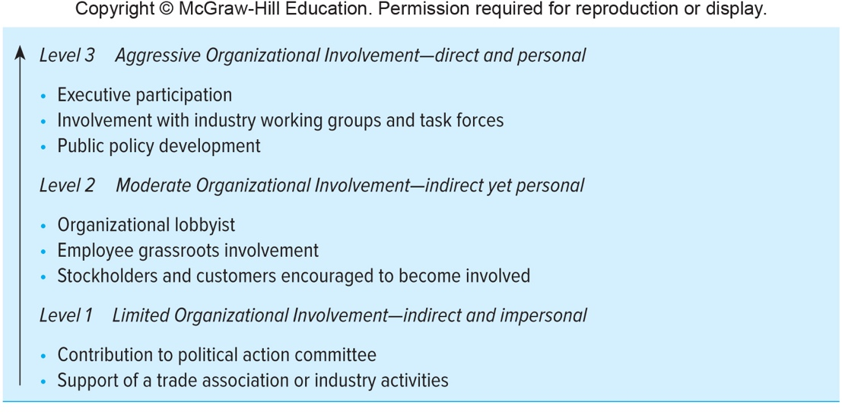
Levels of Business Political Involvement1
Figure 8.5
Copyright © McGraw-Hill Education. Permission required for reproduction or display.
Access the text alternative for these images.

Slide 13
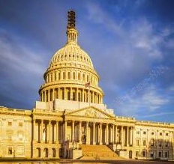
Managing the Political Environment
The role of the public affairs department
Typical public affairs executive duties
Bundling
Notes:
The role of the public affairs department:
To manage the firm’s interactions with governments at all levels.
To promote the firm’s interests in the political process.
Typical public affairs executive duties:
Direct lobbying with federal or state politicians.
Host visits by politicians to the company’s locations.
Attend funding raising activities.
Participate in coalition building.
Bundling: the company takes all of the contributions to the candidates, clearly indicating that the contributions are from the firm’s stockholders.

Slide 14

Business Political Action Abroad
Managers must be aware of the opportunities for and restrictions on business involvement in the political processes in other countries.
Issues:
  participation in the political environment.
  campaign financing.
  fair ethical climate throughout the public policy process.
Example: EU antitrust case and the Right To Be Forgotten controversy at Google.

Slide 15
How does this compare to our closest ally: Canada
Canada’s federal election finance laws put limits on contributions to political parties and candidates. Only individuals — not corporations or trade unions — may donate. Contributions are limited to up to $1,500 a year to each political party and up to $1,500 to all of the registered electoral district associations, contestants seeking the party’s nomination and candidates for each party. In addition, donors may give up to $1,500 to leadership contestants for a party as well as up to $1,500 to independent candidates. These limits were set in 2015, and the amounts increase by $25 each year. Political actors must disclose the names of anyone who donates more than $200.
(Source: The Canadian Encyclopedia)

Slide 16
Influencing the Political
Environment
Chapter 8
©2020 McGraw-Hill Education. All rights reserved. Authorized only for instructor use in the classroom. No reproduction or further distribution permitted without the prior written consent of McGraw-Hill Education.

